Slide 1


NUS Smart Event Scheduler
Group 19: ZHU KAIXU
CHEN XINYU
部门：运营部

Slide 2


Table of contents
1
2
System Architecture
Multi-Agent Framework
3
4
Scheduling Engine & Optimization
Intelligence Enhancements
5
6
Evaluation
Conclusion

Slide 3

01
System Architecture

Slide 4

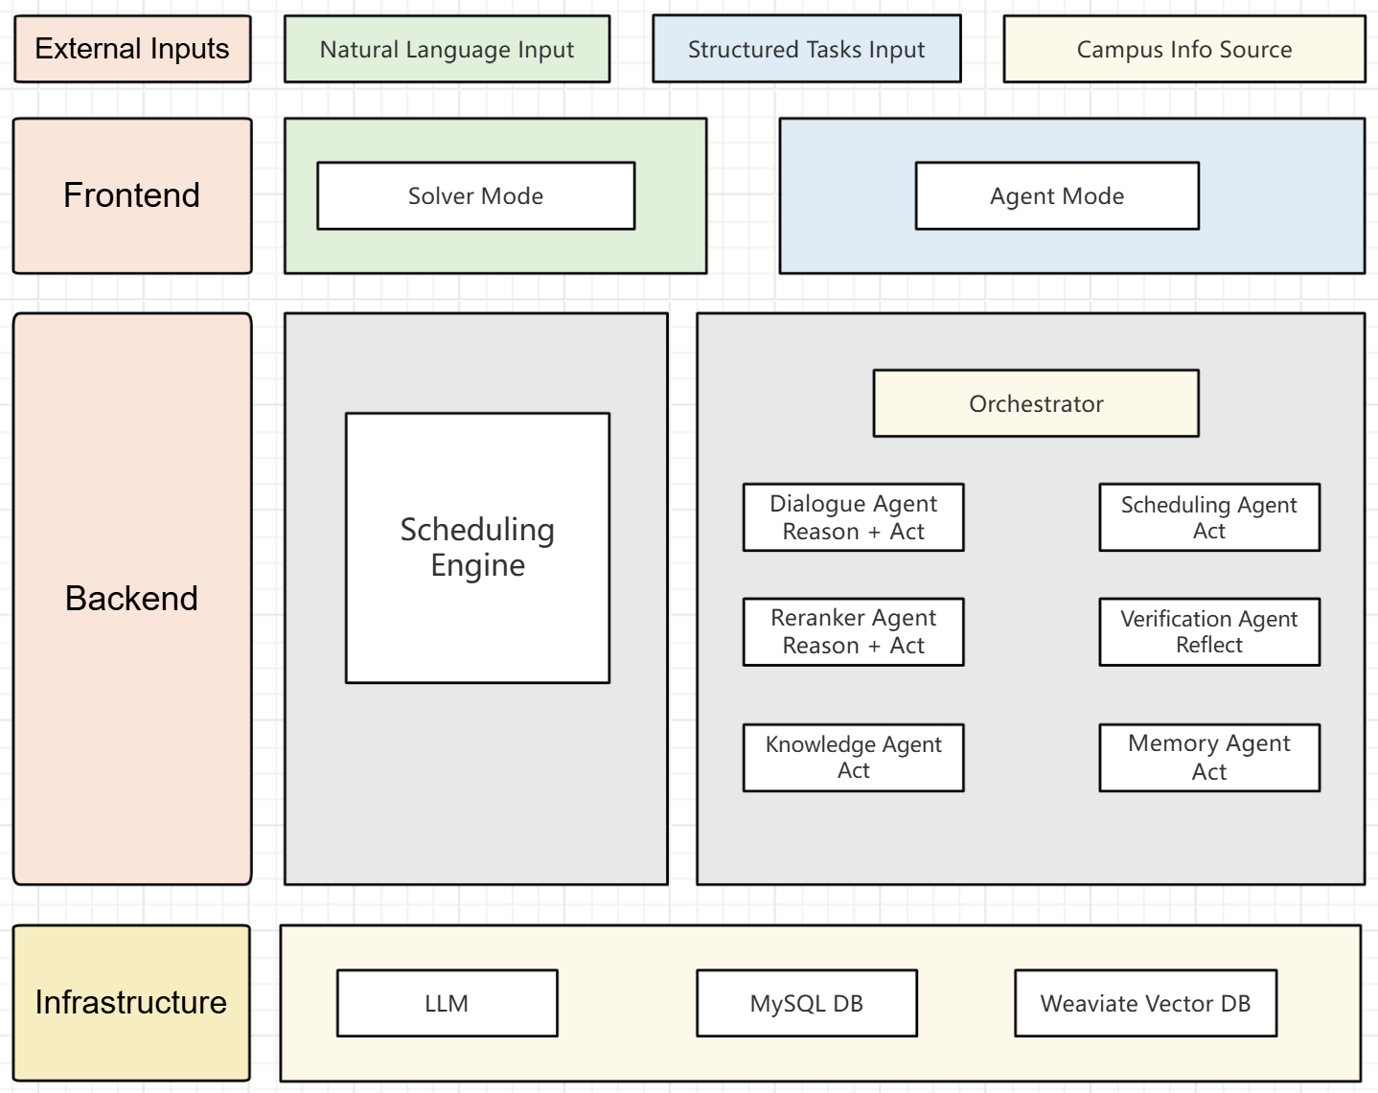
Modern Image Capture

Slide 5
02
Multi-Agent Framework

Slide 6
Why Multi-Agent?
A single model cannot handle understanding, retrieval, memory, optimization, and validation simultaneously
Division of responsibilities → modular, scalable, explainable
Powered by ReAct (Reason + Act + Reflect) loop

Slide 7
Agent Responsibilities
Dialogue Agent (Reason + Act) Parse natural language → generate task structures
Knowledge Agent (Act) RAG retrieval of campus information or user profile
Memory Agent (Act) Load user preferences & historical behaviors
Reranker Agent (Reason + Act) Reorder candidates, filter noise, improve relevance
Scheduling Agent (Act) Invoke solver to generate optimized schedule
Verification Agent (Reflect) Validate constraints, detect issues, provide feedback

Slide 8
03
Scheduling Engine

Slide 9
Scheduling Engine
Custom Lightweight Task Model
Convert raw tasks into modify model. Enables efficient constraint checking and flexible manipulation
Greedy Construction of Feasible Schedule
Sort tasks by window tightness, fixed status, and priority, then insert each task at the earliest feasible slot respecting overlap and travel constraints to guarantee an initial valid schedule.

Slide 10
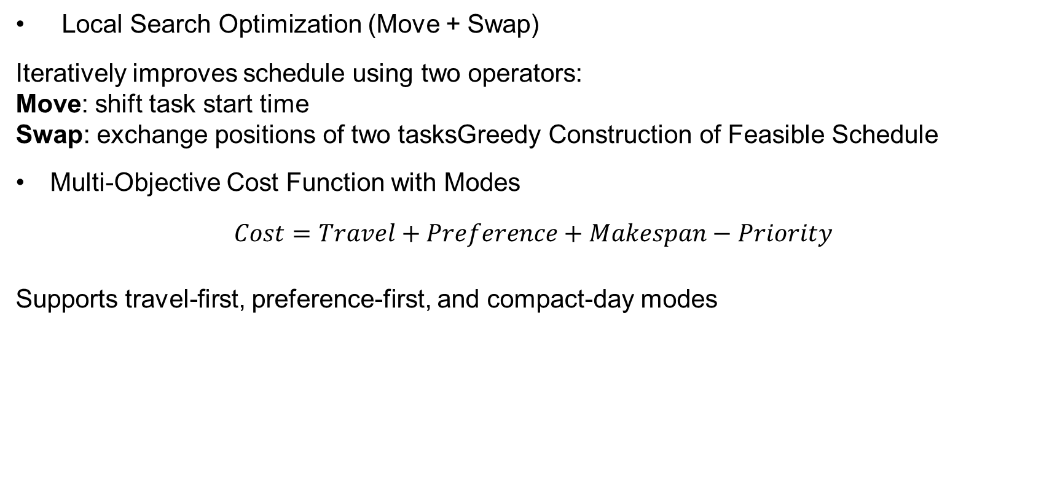
Scheduling Engine
Local Search Optimization (Move + Swap)
Iteratively improves schedule using two operators:
Move: shift task start time
Swap: exchange positions of two tasksGreedy Construction of Feasible Schedule
Multi-Objective Cost Function with Modes
$$Cost=Travel+Preference+Makespan−Priority$$
Supports travel-first, preference-first, and compact-day modes

Slide 11
04
Intelligence Enhancements

Slide 12
Intelligence Enhancements
Retrieval-Augmented Generation
Memory-Based Personalization
Reranker Agent
ReAct-Driven Iterative Refinement

Slide 13
05
Evaluation

Slide 14
Evaluation
Reranker Evaluation
Goal: Improve relevance of retrieved knowledge

Slide 15
Evaluation
Solver Evaluation
Compared With: Greedy Baseline
Modes Tested: Travel-first, Preference-first, Compact-day

Slide 16
06
Conclusion

Slide 17
Conclusion
This project delivers an intelligent scheduling system that integrates multi-agent reasoning, RAG, memory-based personalization, and a hybrid optimization solver.
Through the ReAct loop and adaptive preference learning, it generates schedules that are both feasible and user-centric. Experiments show clear improvements over traditional methods, validating the effectiveness of our design.

Slide 18
Thanks
部门：运营部

